Slide 1
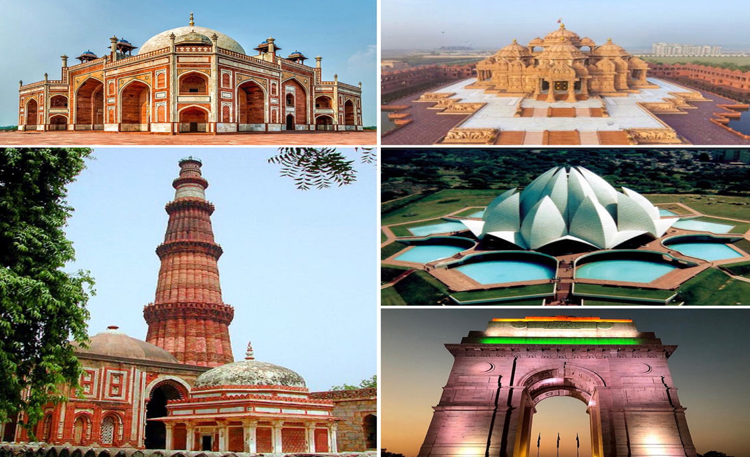
IBM DATA SCIENCE CAPSTONE
OPENING A NEW RESTAURANT IN DELHI, INDIA
MUTHURAJESH GUNASINGH
AUGUST 2020

Slide 2
BUSINESS PROBLEM
The business problems that the client faces in opening a restaurant are as follows:
Selecting the best location for the restaurant in the city of Delhi, India.
Target audience that the restaurant will cater to.
Other factors to be considered for opening the restaurant.
We will use data science methodology and machine learning techniques like clustering to provide solutions to our client. We will analyze the neighborhoods in the city of Delhi, India and select the best location for the restaurant. We will also provide our insights in the report which will answer all the queries faced by our client.

Slide 3
DATA
To solve the problem, we will use the following data:
List of neighborhoods in Delhi, India.
Latitude and Longitude coordinates of those neighborhoods.
Venue data in order to identify the most common venues within the clusters.
The data of neighborhoods is collected from Wikipedia while the latitude and longitude coordinates of the neighborhoods is collected from Google.

Slide 4
METHODOLOGY
The complete data containing neighborhoods, latitudinal and longitudinal coordinates is stored in a CSV file which will be used to produce the pandas dataframe using Python.
Foursquare API will be used to get the venue data for those neighborhoods
The Machine Learning technique (K-means clustering) will be used to cluster the neighborhoods.
Data visualization technique(Folium) will be used to produce the neighborhood and cluster maps.
The Delhi population and districts data contained in CSV files will also be analyzed to provide further insights to client with respect to the best location for the restaurant.

Slide 5
METHODOLOGY
The Python file contains five parts which are as follows:
PART 1: DATAFRAME WITH NEIGHBORHOODS AND GEOGRAPHICAL COORDINATES
PART 2: EXPLORE THE NEIGHBORHOODS IN DELHI, INDIA
PART 3: CLUSTER THE NEIGHBORHOODS OF DELHI, INDIA
PART 4: DISTRICTS IN DELHI, INDIA
PART 5: POPULATION – DISTRICT WISE IN DELHI, INDIA

Slide 6
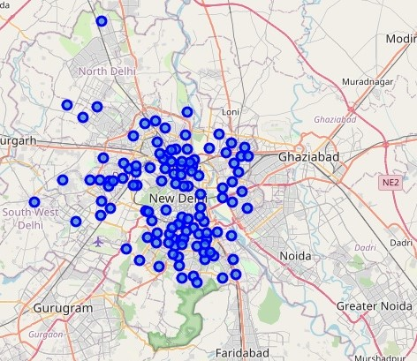
RESULTS
The results of the five parts of the report area as follows:
PART 1: DATAFRAME WITH NEIGHBORHOODS AND GEOGRAPHICAL COORDINATES
1. As per data, there are 116 neighborhoods in Delhi.
2. Delhi’s urban area including neighboring satellite cities is the world’s second largest urban area according to the United Nations (Wikipedia).
PART 2: EXPLORE THE NEIGHBORHOODS IN DELHI, INDIA
1. Since the theme of the restaurant that the client intends to open is “Street Food”, we consider Fast Food Restaurants as the main competition.

Slide 7
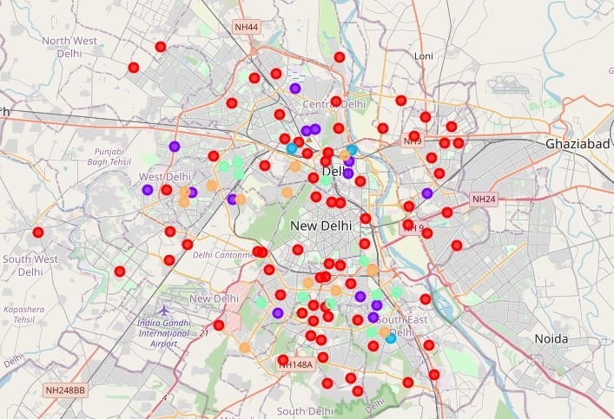
RESULTS
2. There are 45 Fast Food Restaurants in Delhi. Considering the size of Delhi, the number is very low.
3. When we look at the top ten venues for each neighborhood, we find that restaurants and various other food outlets are most common in the list. This indicates that Delhi people prefer eating out.
PART 3: CLUSTER THE NEIGHBORHOODS OF DELHI, INDIA
1. Using Machine Learning technique (K-Means Clustering), we have divided Delhi’s neighborhoods into five clusters.

Slide 8
RESULTS
2. Apart from cluster 0, all other clusters have Fast Food Restaurants in all the neighborhoods. Only five neighborhoods in Cluster 0 have Fast Food Restaurants.
3. Also, Cluster 0 has the highest number of neighborhoods (74) accounting for 64% of the total neighborhoods in Delhi . The second and third clusters in terms of neighborhoods is Cluster 1 (14) and cluster 4 (12).
PART 4: DISTRICTS IN DELHI, INDIA
1. Delhi is divided into nine districts – North West Delhi, North Delhi, North East Delhi, Central Delhi, New Delhi, East Delhi, South Delhi, South West Delhi, and West Delhi.
2. As per data, South Delhi contains the maximum number of neighborhoods (37) followed by South West Delhi (15) and West Delhi (13).

Slide 9
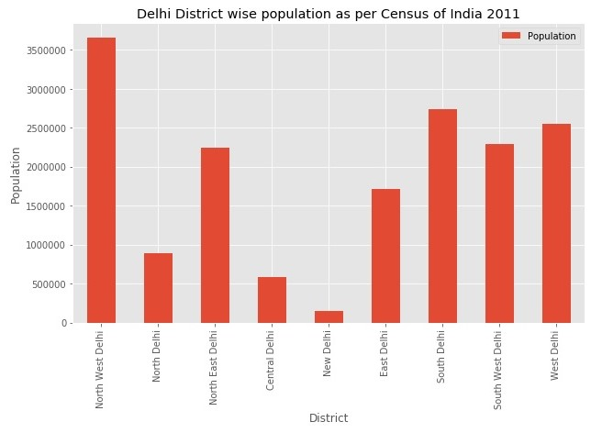
RESULTS
PART 5: POPULATION – DISTRICT WISE IN DELHI, INDIA
1. As per data, North West Delhi is the most populated district in Delhi (3656539) followed by South Delhi (2731929) and West Delhi (2543243).
2. Delhi is second most populated city in India and fifth most populous city in the world (Wikipedia).
3. Delhi ranks fifth in the world in terms of population density (9340 persons/ Sq. km) (Wikipedia).

Slide 10
DISCUSSION
Location is of prime importance when deciding to open a restaurant. The location selected should ensure that the restaurant faces less competition. Since the restaurant will serve street food, we decided to get information of Fast-Food Restaurants in Delhi which we consider as the main competitors.
Cluster 0 with 74 neighborhoods has only five neighborhoods with Fast Food Restaurants compared to other clusters where all neighborhoods have Fast Food Restaurants. Hence, we have selected the cluster to open the restaurant.
We have further trimmed the number of neighborhoods in Cluster 0 based on districts with high population. The trimmed list contains 33 neighborhoods – North West Delhi (7), South Delhi (23) and West Delhi (3).

Slide 11
RECOMMENDATIONS
We recommend the client to open his “Street Food Restaurant” in the neighborhoods of South Delhi (23) from cluster 0. The reason being South Delhi is second most populated and expensive area in Delhi.
We suggested to the client to consider “International Street Food” as the theme of the restaurant. Since South Delhi is an expensive area, the local population will be interested in international food options. They will readily connect with the theme of the restaurant.
The theme of “International Street Food” will also act as a differentiation factor preventing competition from local street vendors and Fast-Food Chains selling pizzas and burgers.
We also recommend the client to consider food quality, restaurant layout and customer service equally important in order to ensure that customers come to the restaurant on a regular basis as well as recommend it to other people.

Slide 12
CONCLUSION
We suggest that the client should open the restaurant in one of the 23 neighborhoods of South Delhi from Cluster 0 with a theme of “International Street Food” and give equal importance to food quality, restaurant layout and customer service.

